Slide 1


Charge Injection System (CIS) Update
Katie Hughes, Dawit Belayneh
The University of Chicago
October 4, 2021

Slide 2
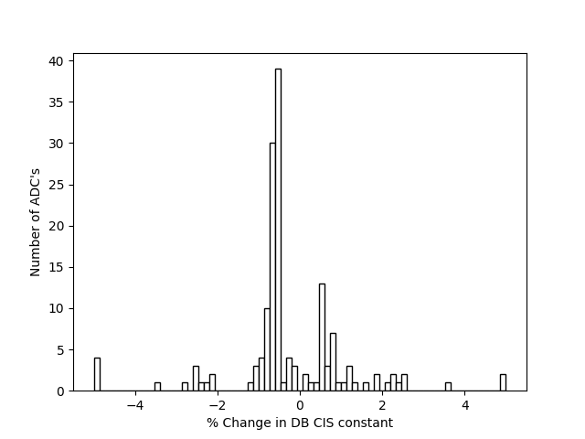
Summary
Updated Channels
Updated on Sept. 28
CIS runs from Aug. 23 - Sept. 24
153 channels in the update
6 with >5% change in DB value

Slide 3
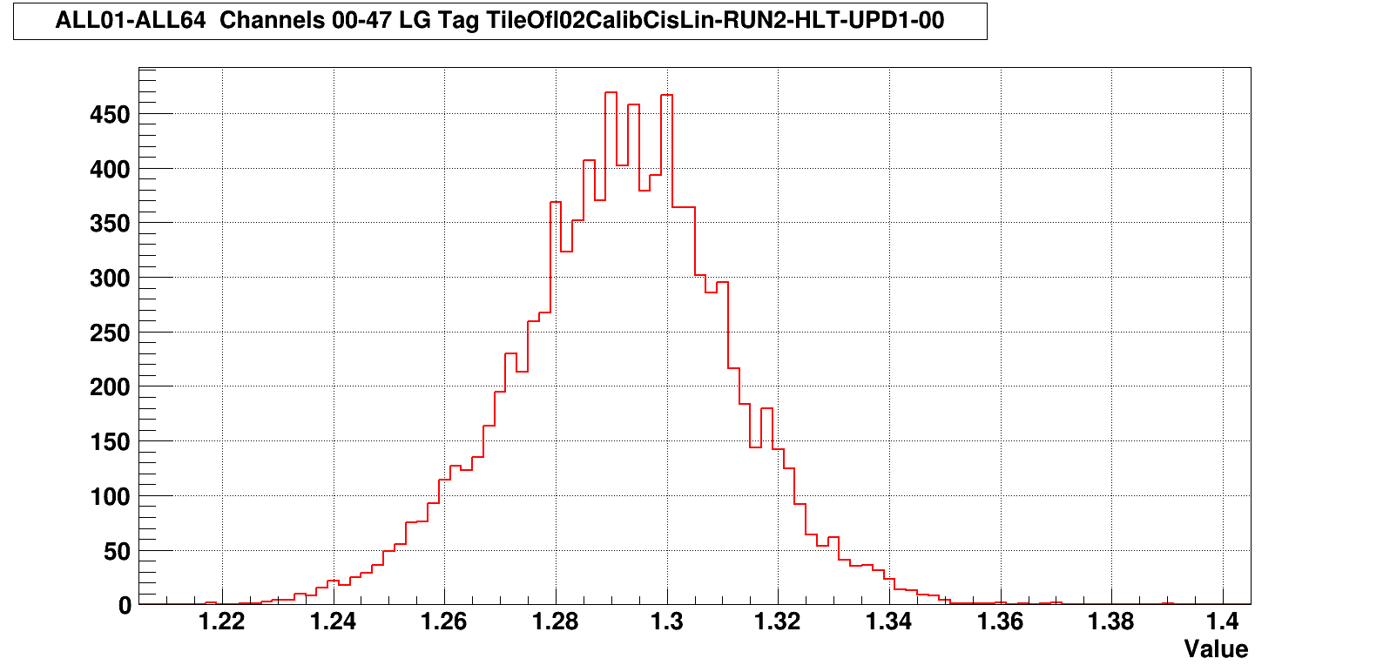
CIS constant distributions: lowgain

Slide 4
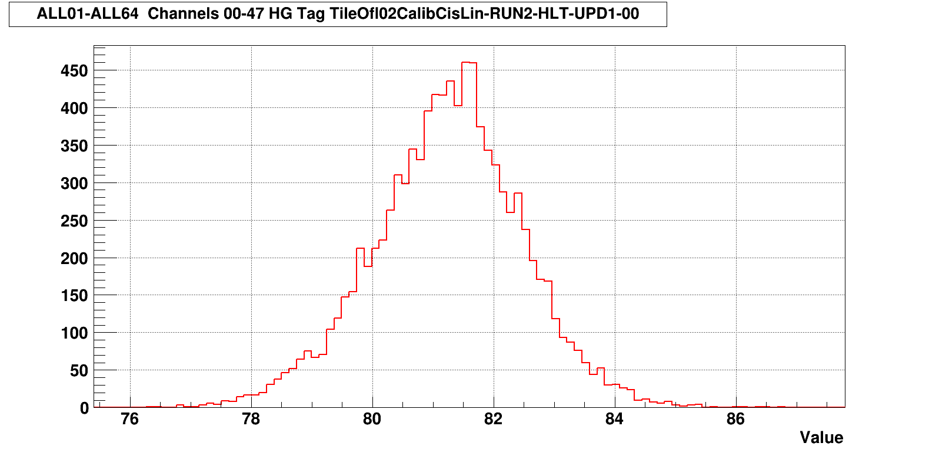
CIS constant distributions: highgain

Slide 5
Removing Bad Runs

Slide 6
Full List of CIS scan taken in Sep-2021
run [399940, 'CIS', '2021-08-23 10:13:25,2021-08-23 10:15:03']
run [400063, 'CIS', '2021-08-23 21:33:36,2021-08-23 21:35:18']
run [400103, 'CIS', '2021-08-24 18:12:02,2021-08-24 18:13:16']
run [400323, 'CIS', '2021-08-27 18:33:23,2021-08-27 18:34:46']
run [400558, 'CIS', '2021-09-01 00:48:50,2021-09-01 00:50:25']
run [400656, 'CIS', '2021-09-01 16:29:51,2021-09-01 16:31:10']
run [400841, 'CIS', '2021-09-03 13:08:05,2021-09-03 13:09:27']
run [400899, 'CIS', '2021-09-03 19:48:18,2021-09-03 19:49:21']
run [401001, 'CIS', '2021-09-07 10:43:57,2021-09-07 10:45:30']
run [401325, 'CIS', '2021-09-10 11:37:28,2021-09-10 11:39:06']
run [401520, 'CIS', '2021-09-14 22:37:24,2021-09-14 22:38:47']
run [401630, 'CIS', '2021-09-17 10:34:44,2021-09-17 10:36:25']
run [401631, 'CIS', '2021-09-17 10:40:21,2021-09-17 10:41:53']
run [401632, 'CIS', '2021-09-17 10:47:06,2021-09-17 10:48:42']
run [401633, 'CIS', '2021-09-17 10:56:27,2021-09-17 10:58:17']
run [401687, 'CIS', '2021-09-17 20:06:41,2021-09-17 20:08:37']
run [401694, 'CIS', '2021-09-20 10:42:58,2021-09-20 10:44:24']
run [401695, 'CIS', '2021-09-20 10:49:32,2021-09-20 10:51:15']
run [401696, 'CIS', '2021-09-20 10:56:25,2021-09-20 10:57:50']
run [401697, 'CIS', '2021-09-20 11:01:29,2021-09-20 11:03:06']
run [401898, 'CIS', '2021-09-21 22:08:47,2021-09-21 22:10:32']
run [402124, 'CIS', '2021-09-24 21:54:13,2021-09-24 21:55:41']

Slide 7
Runs Used by Partition and Gain
LBA_lowgain: 400103 400323 400558 400656 401001 401325 401520 401632 401633 401687 401696 402124
LBA_highgain: 400103 400323 400558 400656 400841 400899 401001 401325 401520 401632 401687 401696 402124
LBC_lowgain: 400063 400103 400558 400656 400899 401001 401325 401520 401633 401687 401696 401898 402124
LBC_highgain: 400063 400103 400656 400899 401001 401325 401632 401633 401687 401696 401898
EBA_lowgain: 401633 401687 401696 401898 402124
EBA_highgain: 400063 400103 400323 400656 400841 400899 401325 401520 401633 401687 401696 401898 402124
EBC_lowgain: 400063 400103 400323 400558 400656 400899 401001 401325 401520 401633 401687 401696 401898 402124
EBC_highgain: 400063 400103 400323 400558 400899 401001 401325 401520 401632 401696 401898 402124

Slide 8
Run Selection Method
If multiple runs taken within an hour: only use one run for a particular partition/gain combination
run [401630, 'CIS', '2021-09-17 10:34:44,2021-09-17 10:36:25']
run [401631, 'CIS', '2021-09-17 10:40:21,2021-09-17 10:41:53']
run [401632, 'CIS', '2021-09-17 10:47:06,2021-09-17 10:48:42']
selected run has to have appropriate Amp/Q and Timing plots for partition/gain combination

Slide 9
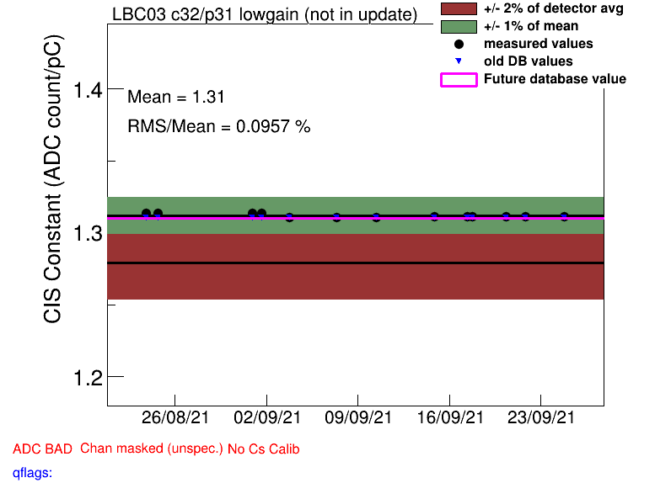
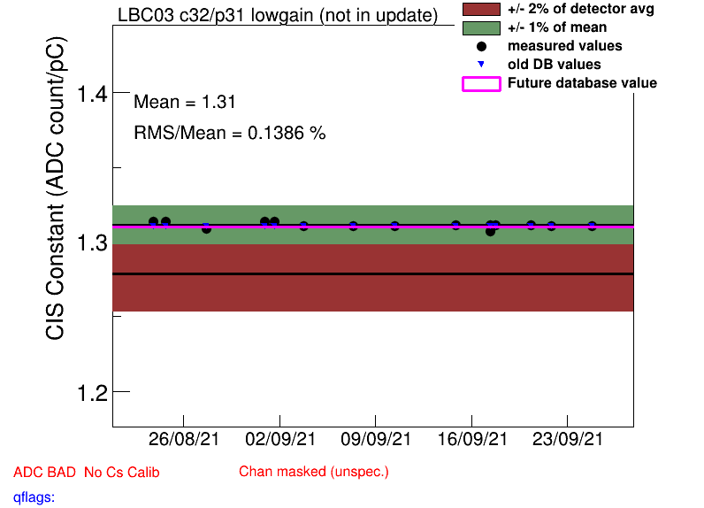
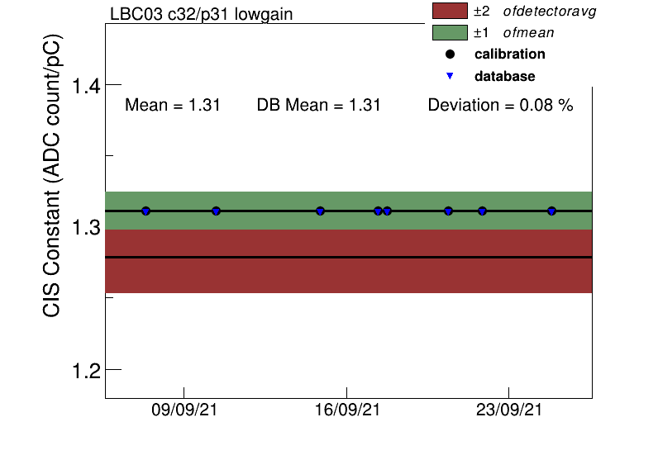
Before and After Run Selection
After selection
Before selection
recalibration

Slide 10
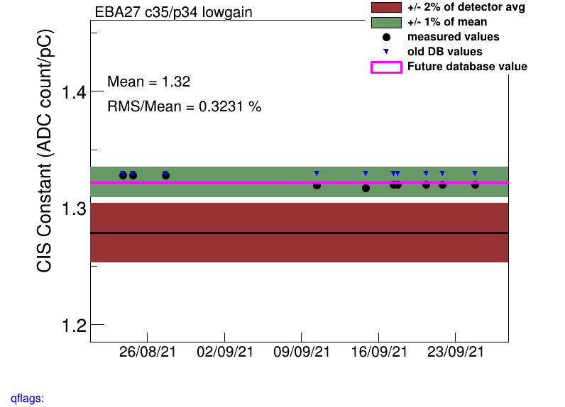
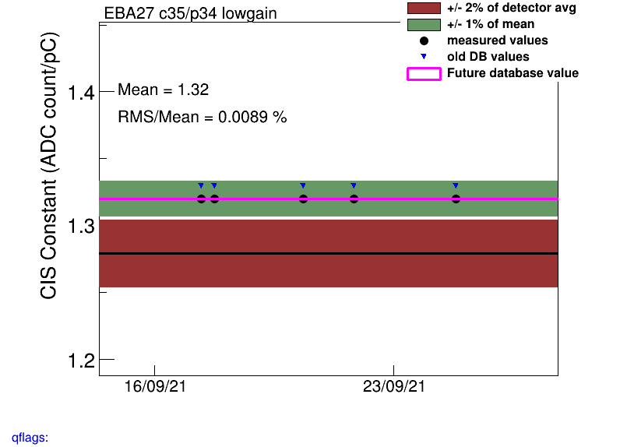
EBA_lowgain
Valid Runs initially: 400063 400103 400323 401325 401520 401633 401687 401696 401898 402124
Most channels would have to be recalibrated around 9/16. Instead of doing this all manually, we preemptively trimmed the list of valid runs to: 401633 401687 401696 401898 402124

Slide 11
Interesting channel behaviour

Slide 12
Unusually Low/High Channels
EBC_m18_c04_lowgain: 0.79
EBC_m23_c31_lowgain: 0.79
EBC_m26_c01_lowgain: 0.18
EBC_m58_c31_lowgain: 0.02
LBC_m08_c03_lowgain: 1.06
LBC_m23_c20_lowgain: 1.58
EBA_m39_c31_highgain: 72.46
EBA_m50_c31_highgain: 74.19
EBC_m18_c36_highgain: 28.68
EBC_m23_c36_highgain: 68.17
EBC_m37_c40_highgain: 73.57
LBC_m01_c25_highgain: 72.20
LBC_m52_c18_highgain: 103.31
* Many of these are c31, does that mean anything?

Slide 13
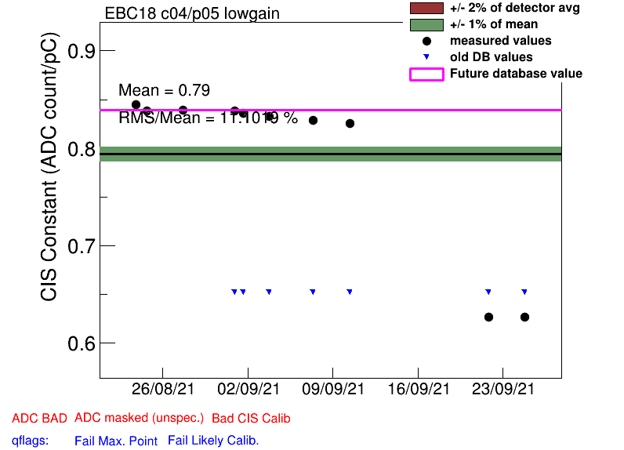
EBC_m18_c04_lowgain

Slide 14
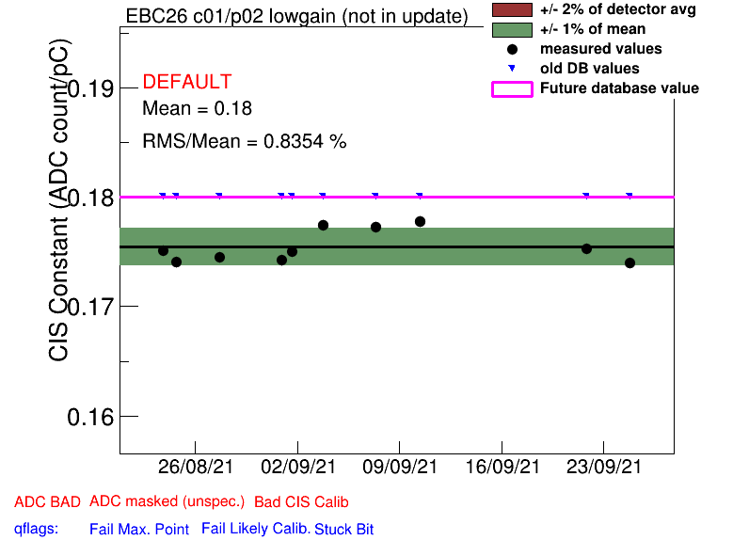
EBC_m26_c01_lowgain

Slide 15
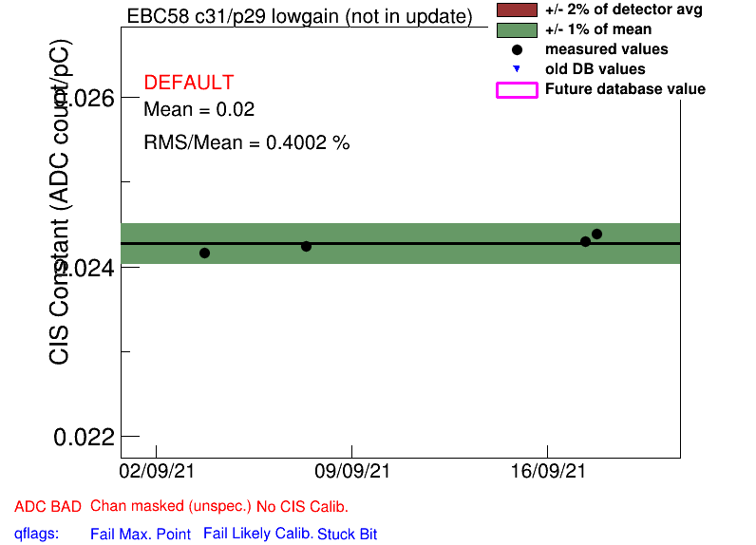
EBC_m58_c31_lowgain

Slide 16
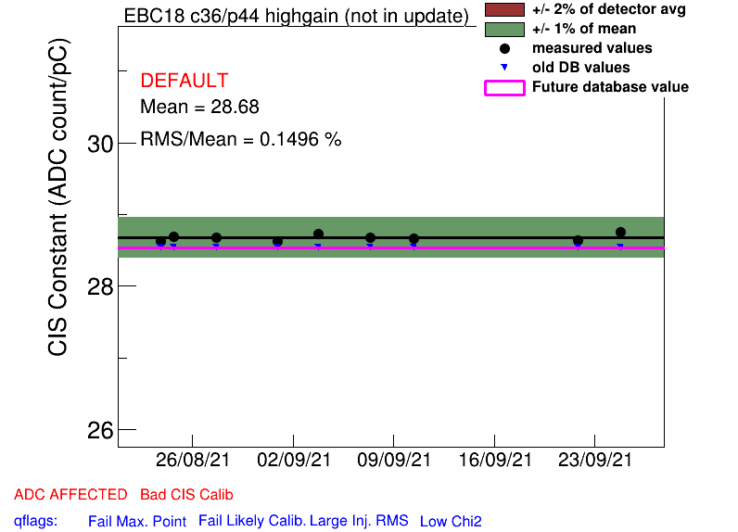
EBC_m18_c36_highgain

Slide 17
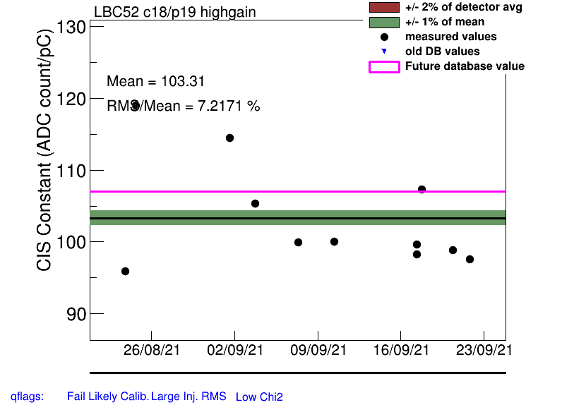
LBC_m53_c18_highgain

Slide 18
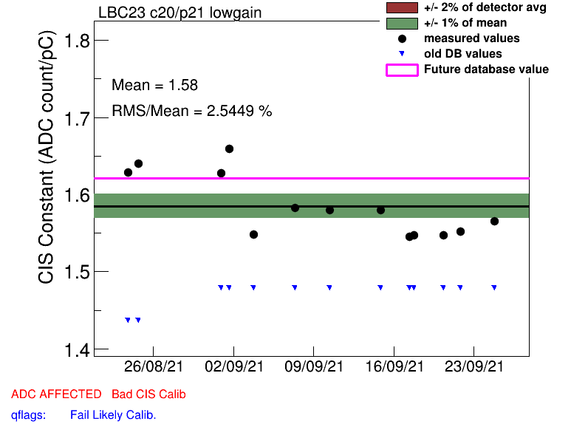
LBC_m23_c20_lowgain

Slide 19
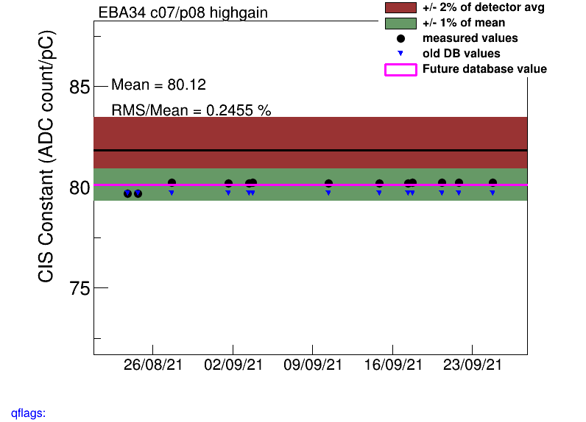
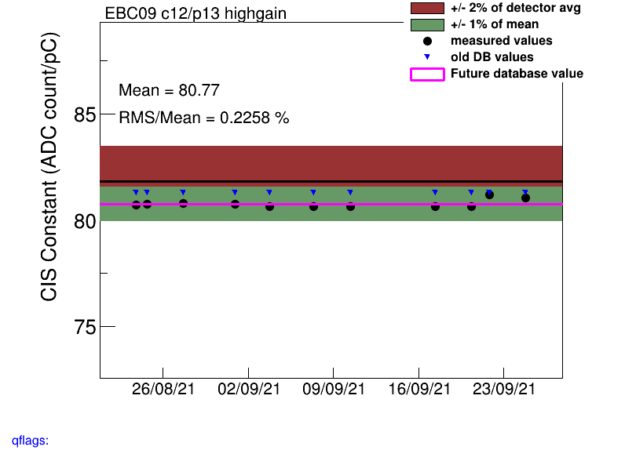
Constant Shifts
EBC_m09_highgain: 9/20
EBA_m34_highgain: 8/26

Slide 20
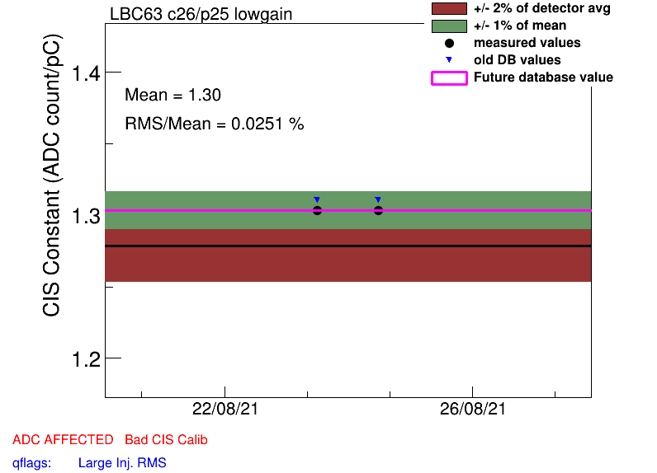
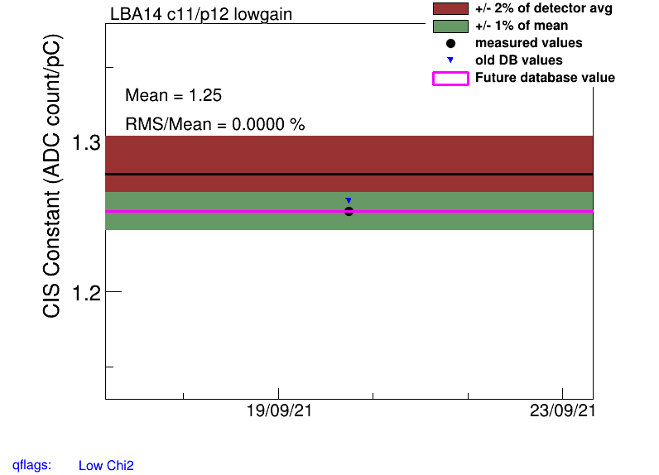
Too Few Points
# of points <= 3 : assigned as bad cis (?)
LBA14, many chns (hg, lg)
LBC63, ch24-35 (hg, lg)
Used 13 runs only 2 visible on plot
EBA25, ch04 (lg)

Slide 21
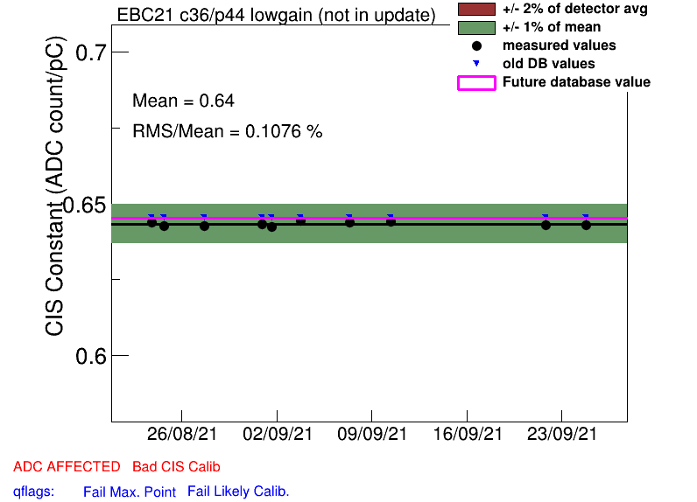
Half Gain Channels
EBA_m15_c08_highgain
EBA_m16_c00_highgain
EBA_m36_c15_highgain
EBA_m64_c03_highgain
EBC_m21_c36_lowgain
EBC_m09_c40_highgain
LBC_m41_c25_highgain

Slide 22
COOL Flag Updates
Add BadCIS
EBA_m28_c05_lowgain
EBA_m08_c10_highgain
EBC_m09_lowgain (many chns)
EBC_m09_c00_highgain
EBC_m09_c02_highgain
EBC_m09_c08_highgain
EBC_m09_c15_highgain
EBC_m09_c21_highgain
EBC_m09_c23_highgain
EBC_m15_c16_highgain
EBC_m37_c39_highgain
LBA_m14_lowgain (many chns)
LBA_m14_c00_highgain (all chns)
LBC_m52_c18_highgain
LBC_m63_c24-35_highgain
Remove BadCIS
EBA_m05_c10_lowgain
EBA_m09_c16_lowgain
EBA_m48_c29_lowgain
EBA_m51_c00_lowgain
EBA_m54_c00-11
EBA_m55_c22_highgain
EBC_m43_c36-41
LBA_m02_c06_lowgain
LBA_m03_c17_lowgain
LBC_m08_c33-45_lowgain
LBC_m20_c37_lowgain
LBC_m08_c33_highgain
LBC_m08_c41_highgain
LBC_m10_c37_highgain
LBC_m17_c11_highgain
LBC_m52_c18_highgain

Slide 23
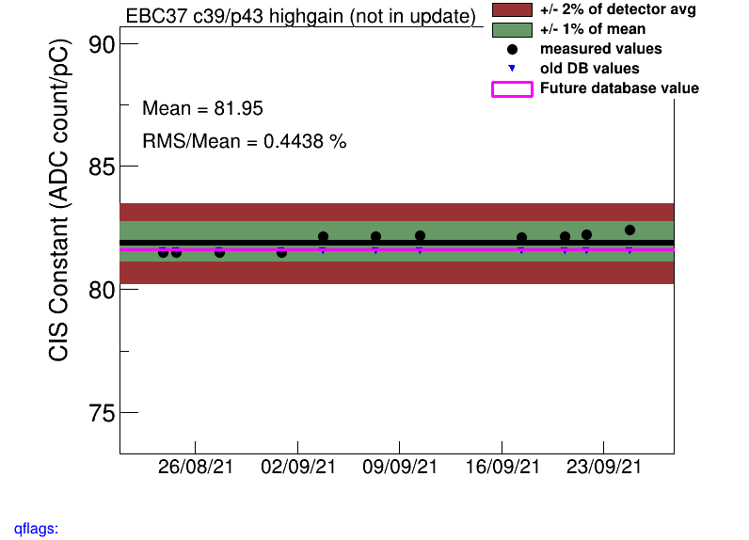
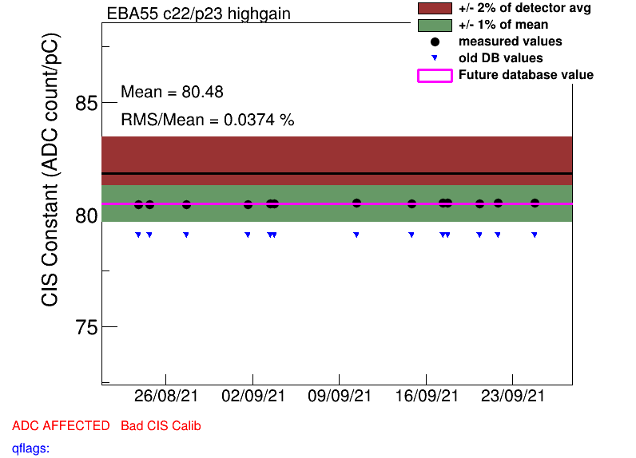
EBC_m37_c39_highgain (Add BadCIS)
EBA_m55_c22_highgain (Remove BadCIS)

Slide 24
Helpful links
Primary CIS tools (twiki)
Running a Monthly CIS Update (guide)
Aug 2021 Update

Slide 25
